Slide 1
HARDWARE INFO FOR EPIC FMS
A Field Management System (FMS) for the Fall Game
Epic Robotz
Fall 2021
This stack contains useful info about various parts of EpicFMS.

Slide 2
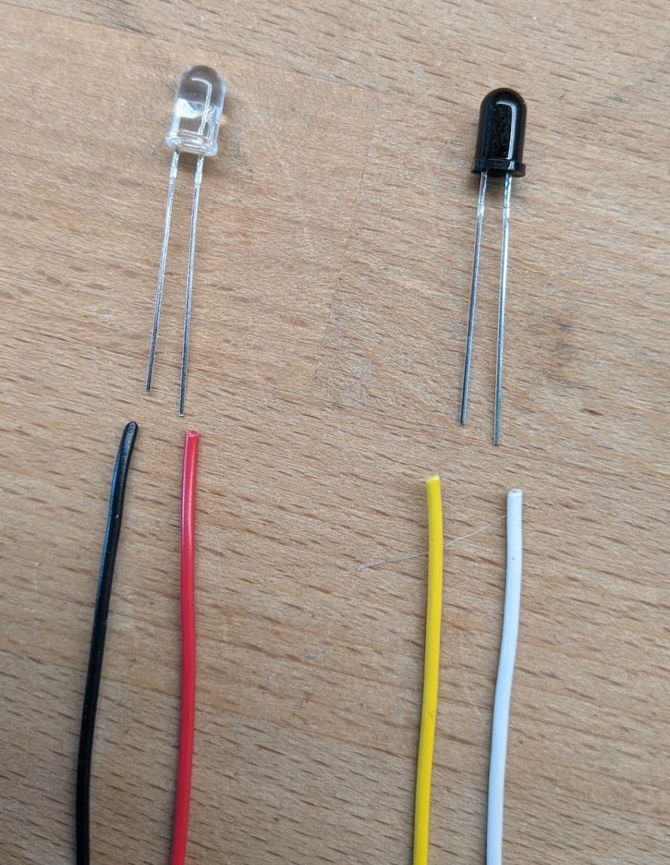
Wiring IR Emitter/Detectors
The CLEAR LED is the Emitter.
Our circuit sends about 17ma of current through this device.
The RED wire carries positive voltage and must be connected to the LONG lead.
The BLACK wire should be connected to the SHORT lead.
Use 24-26 AWG stranded wire.
The Dark Component is the Detector.
When it detects IR light, it allows
current to flow between it’s leads, but
in only one direction: from the short lead
to the long lead.
The YELLOW wire is the positive side and
Must be connected to the SHORT lead.
The WHITE wire is the negative side and
Must be connected to the LONG lead.

Slide 3
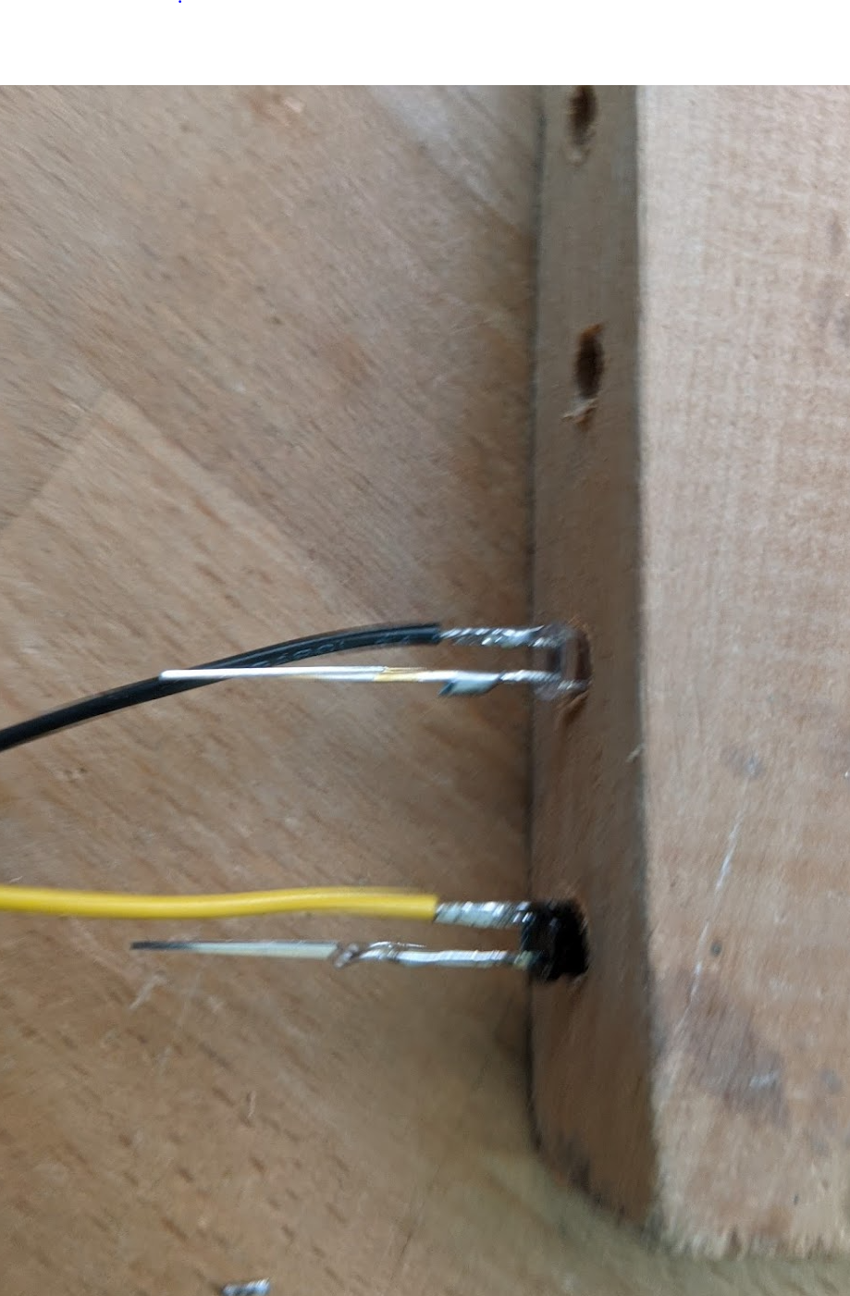
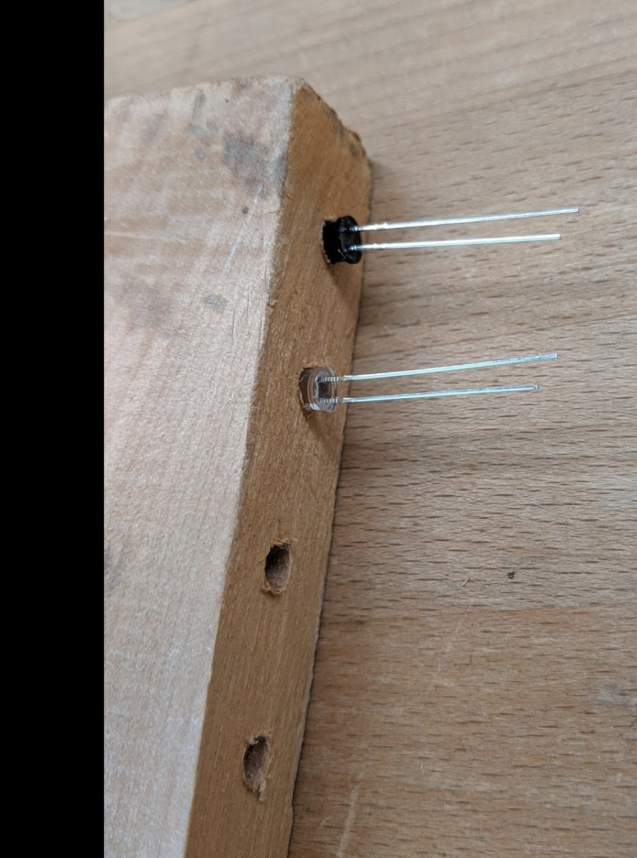
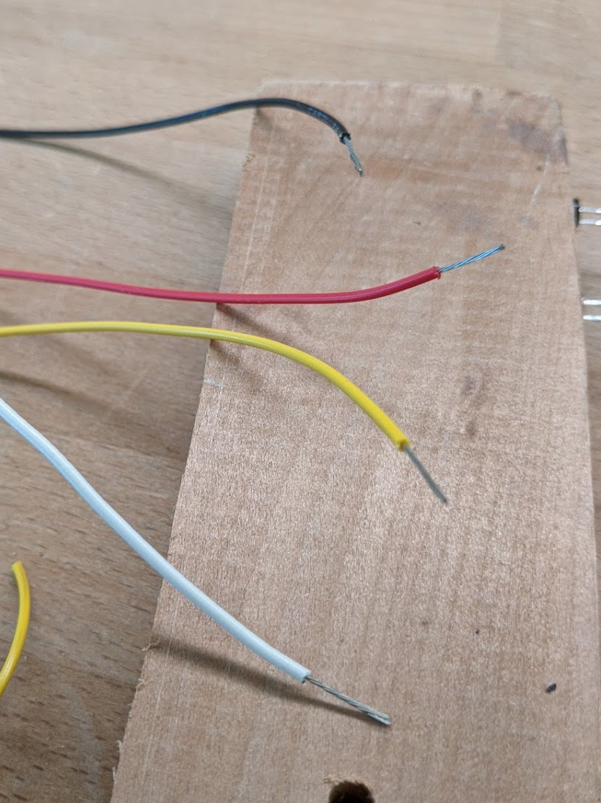
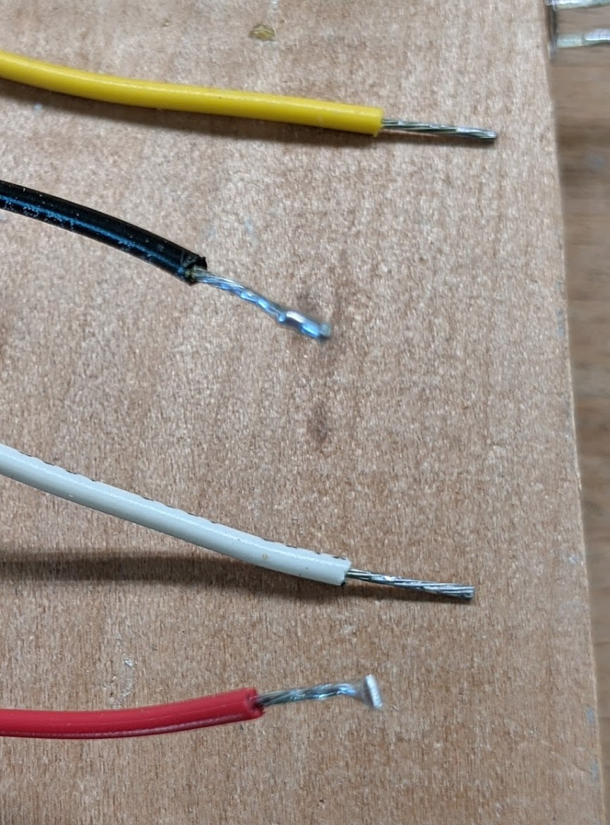
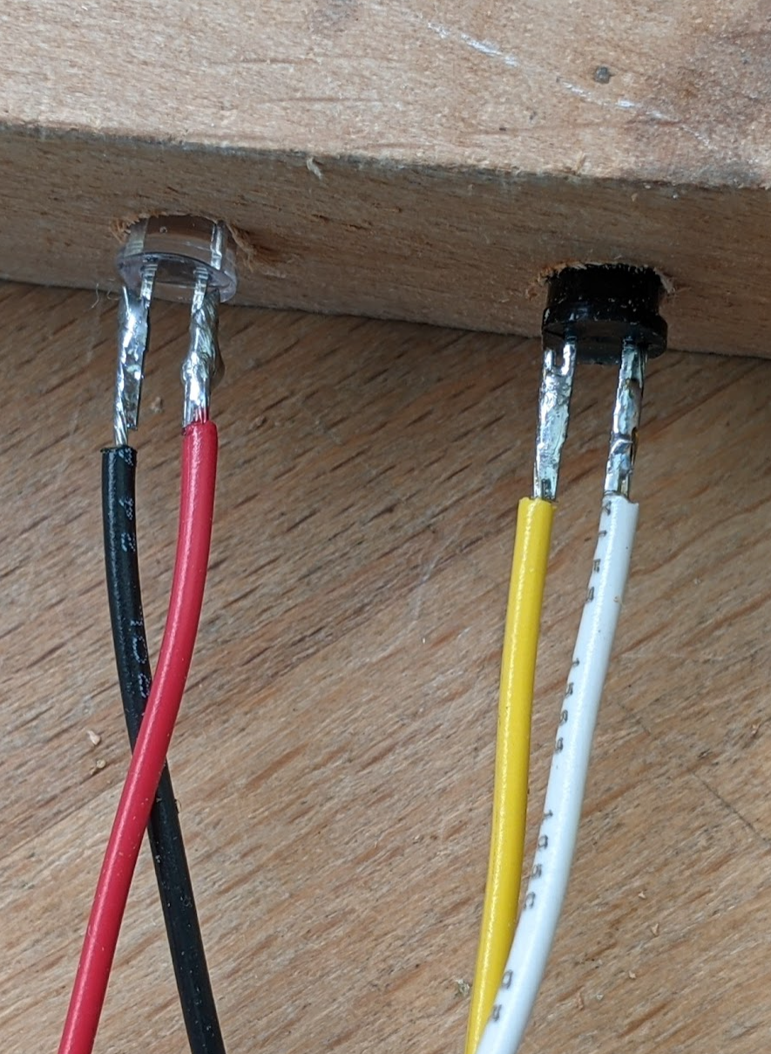
Steps to Solder Wires to the IR Components
Start with the components in the soldering jig with the long leads nearer the top of the jig.
Strip about 0.5 inch of insulation from each wire.
Tin all wires and leads. Then trim the wires so that there is about 3/8 inch of conductor showing.
Cut the short leads to about 3/8 inch. And then use the parallel solder technique to solder the wires.
Do the same for the long leads.
Parallel solder technique: After tinning both wire and lead, bring the wire along side of the lead (i.e., parallel to it), and then heat both with the soldering iron at the same time. Allow the solder to flow between the lead and the wire while holding the wire very steady. Remove the soldering iron while keeping the wire absolutely still until the solder cools.

Slide 4
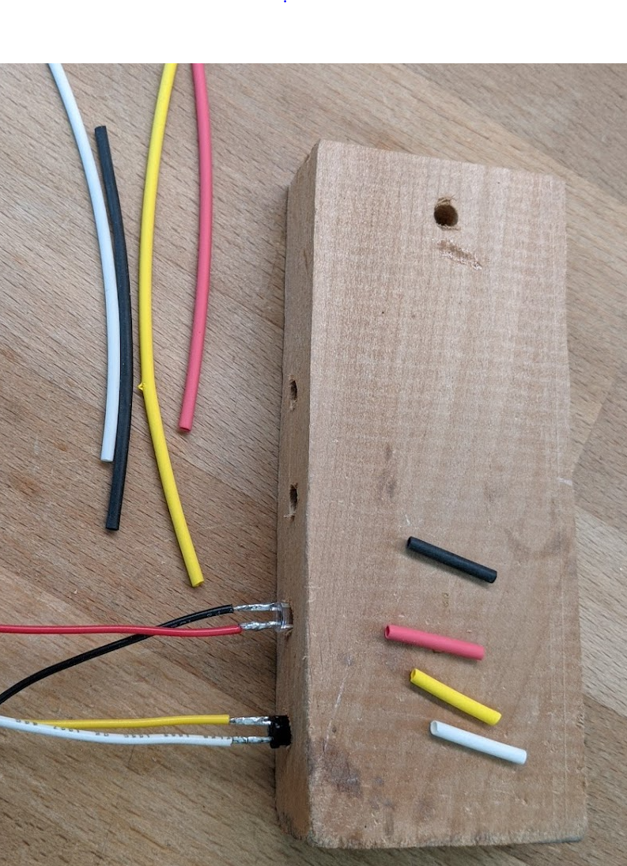
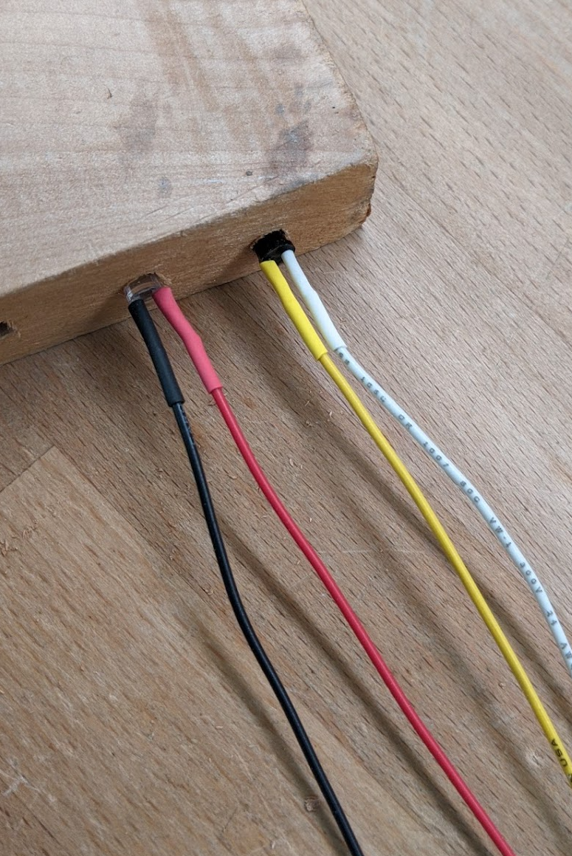
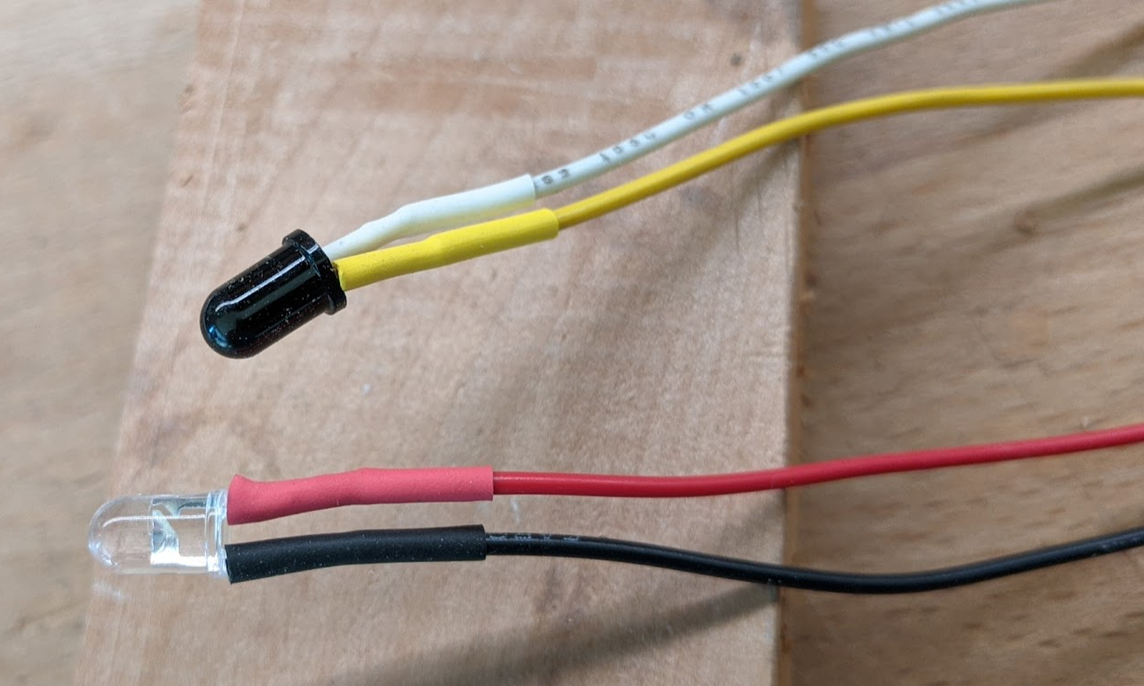
Steps to Finish the Soldered IR Components
Cut about 5/8” of heat shrink tubing for each wire. Try to use the same color. Use 1/16 “ diameter tubing (measured before heat applied).
Slide the heat shrink tubing on each wire all the way to the component. Apply heat with a heat gun. Don’t use a match!
All Done!

Slide 5
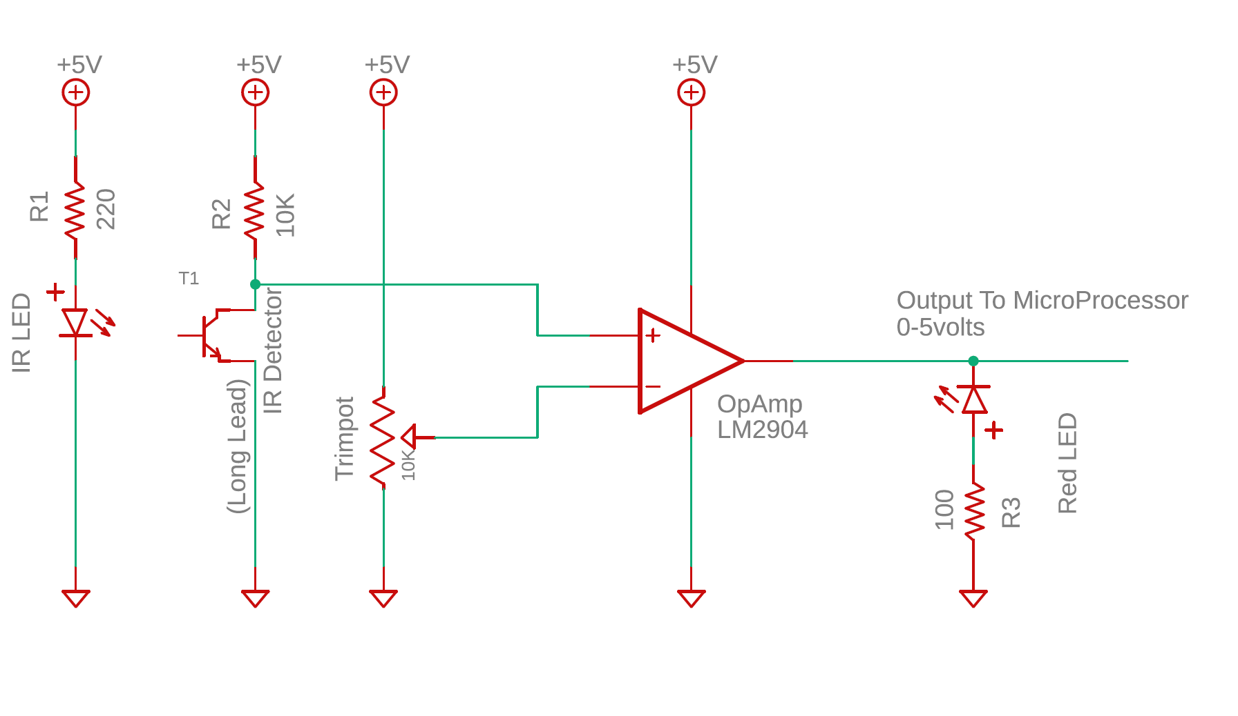
IR Emitter / Detector Test Circuit
Notes:
The IR Emitter, as shown with a 220 ohm resistor draws about 17 mA.
The voltage at the + terminal on the OpAmp runs between 0.12 volts when the beam is detected, and 3.5 volts when the beam is broken.
The OpAmp is wired as a simple comparator. It outputs a hard 0 volts if the beam is detected, and about 3.5 volts if the beam is broken.
The Red LED after the OpAmp is included to indicate when the beam is broken.

Slide 6
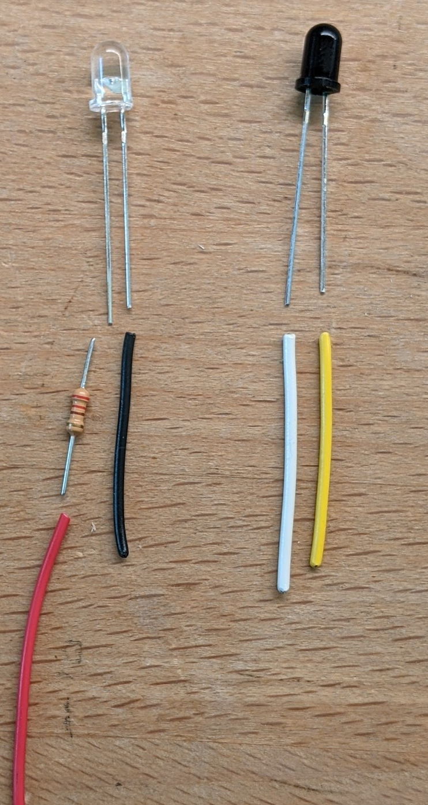
IR Emitter / Detector Wiring
OBSOLETE!! Design Changed.
The Clear LED is the Emitter.
Connect a Red wire to a 220 ohm resister and then to the long lead. On the short lead, connect a black wire.
Use 24-26 AWG stranded wire.
When powered with 5 volts,
Each emitter will draw about 14 mA.
The Dark Blub Component is the Detector.
Connect a white wire to the long lead. Connect a yellow wire to the short lead.
Use 24-26 AWG stranded wire.
In the circuit, the white lead will be connected to ground. When the detector is “on”, current will flow from the yellow wire though the detector to ground.

Slide 7
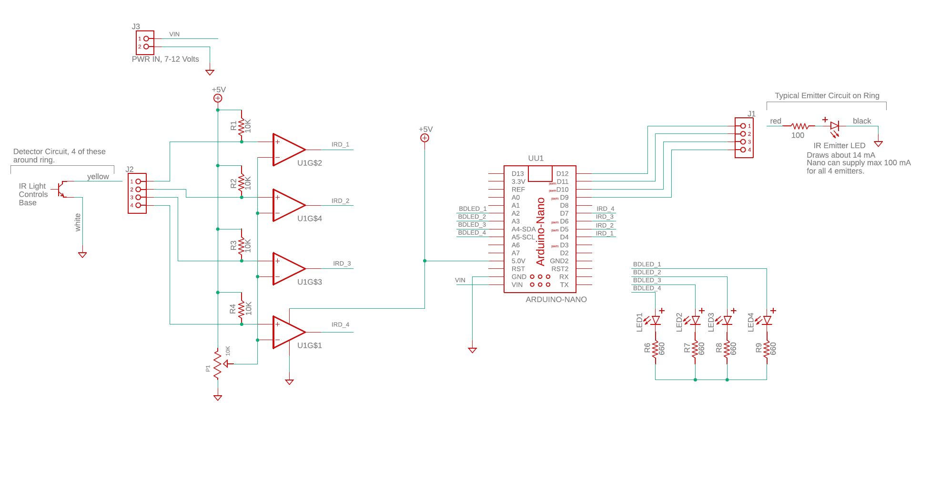
Ring Detection Circuit, Version 1

Slide 8
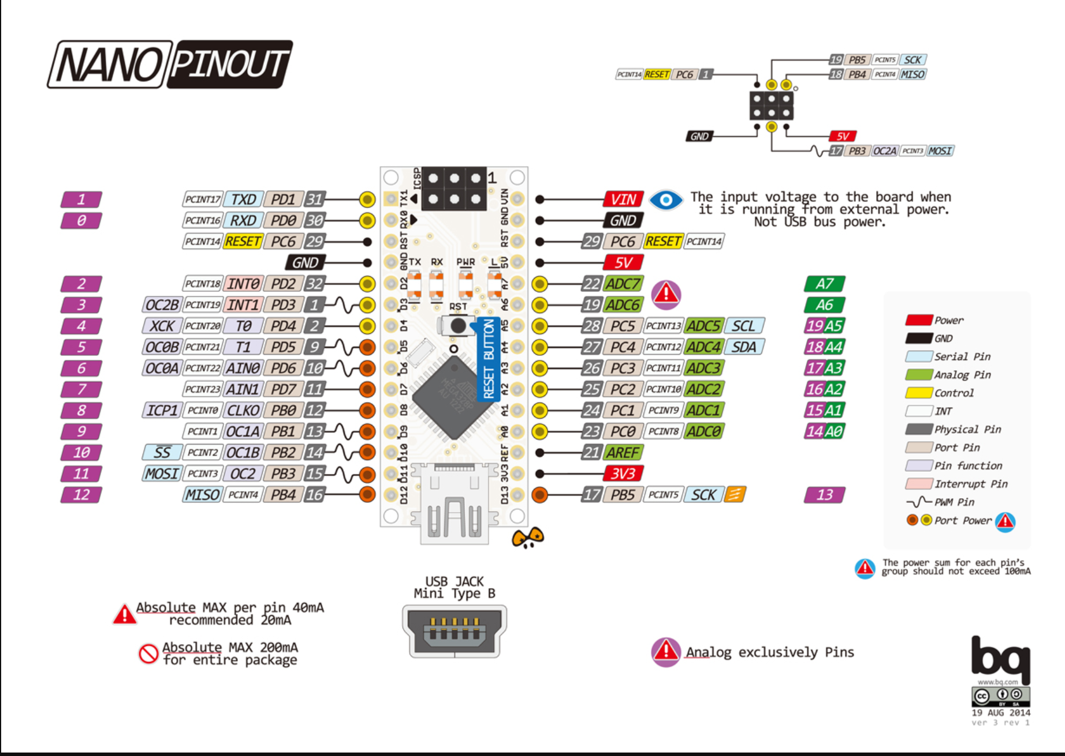
INFO About Arduino NANO – Pin Mappings

Slide 9
